Slide 1


Analysis of the content categories with the largest aggregate popularity

Slide 2


Today's agenda
Project recap
Problem
The Analytics team
Process
Insights
Summary

Slide 3

Social buzz has seen a rapid growth over past 5 years and they need to a firm to oversee their mounting process effectively.
Accenture has begun a 3 month initial project POC focusing on:
An audit of Social buzz’s big data practice
Recommendations for a successful IPO
Analysis to find Social buzz’s top 5 most popular categories in content
Project Recap
Notes:
Explain social buzz
Explain what the project is

Slide 4


Problem
There are 100000 posts per day
36,500,000 pieces of content per year!
But how can they capitalize on this?
Notes:
Explain the problem that social buzz faces

Slide 5




Andrew Fleming
Chief Technical Architect
The Analytics team
Marcus Rompton
Senior Principle
{Myself}
Data Analyst
Notes:
Introduce the team members

Slide 6
Process
1
Data Understanding
2
Data Cleaning
3
Data Modelling
4
Data Analysis
5
Uncover Insights
Notes:
Explain the process how the data is used relating to this project
Data Understanding
Understanding the meaning of the data sets and how the connections are formed.
2. Data Cleaning
Removing the unwanted columns and null rows
3. Data Modelling
This is where data tables connections are formed, tables merged and drawing ERDs.
Data Analysis
Applying statistical and computational techniques to get insights from those data
Uncover Insights
Deriving actionable knowledge and inform decision making

Slide 7

Insights
There are 3 visual insights taken from the dataset of the Social Buzz company. They are,
Top 5 best performing categories
Sum of the Score for the Reaction Types by Quarter year
Sum of the Score of the sentiments by the Content Type

Slide 8
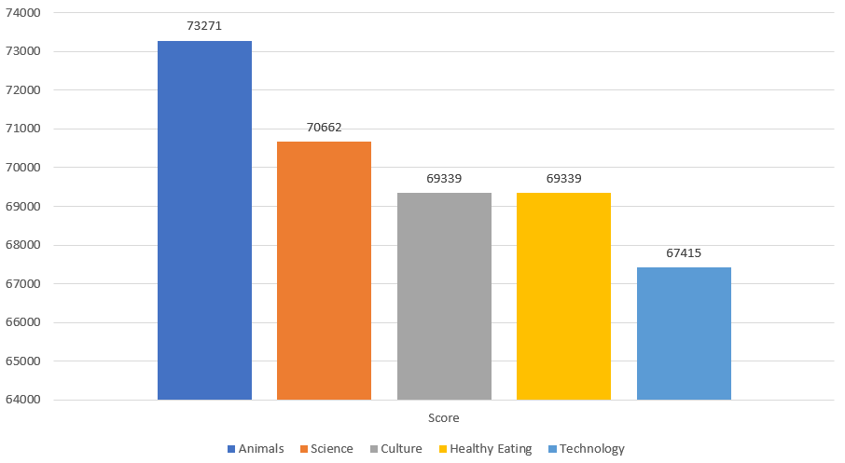
Top 5 best performing categories
Here are 5 best performing content categories,
Notes:
Animals Category:
Animals lead the chart with a score of 74,965.
This category has the highest aggregate popularity among Social Buzz users.
Consider content related to animals as a strong engagement driver.
Science Category:
Science follows closely with a score of 70,662.
Educational and informative content in the science category resonates well with the audience.
Highlight the importance of scientific content for user engagement.
Healthy Eating Category:
Healthy Eating has a score of 69,339.
Content related to nutrition, recipes, and healthy lifestyle choices performs well.
Emphasize the relevance of health-conscious content.
Technology Category:
Technology ranks fourth with a score of 67,415.
While not the top performer, technology content still attracts user interest.
Discuss trends in tech-related topics to improve engagement.
Food Category:
Food content has a score of 67,200.
Although slightly lower, it remains a significant category.
Explore diverse food-related content to maintain user engagement.

Slide 9
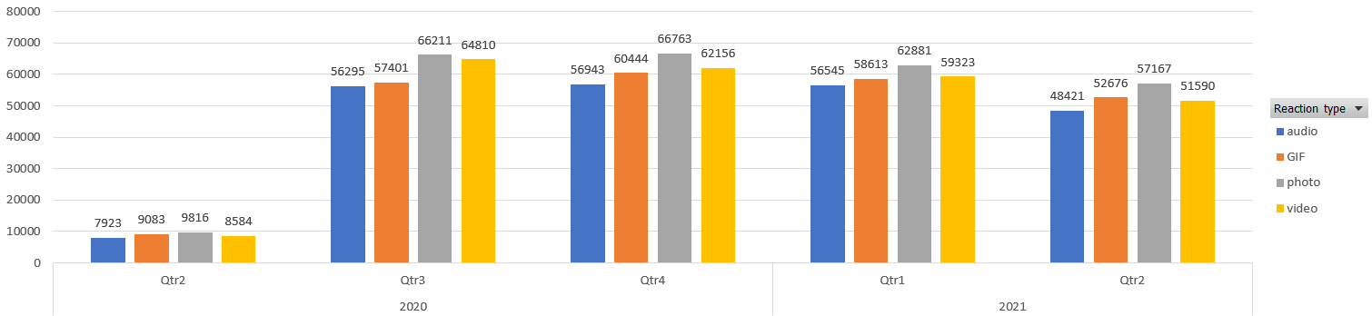
Sum of the Score of Reaction Types by Quarter Year
Here is sum of the scores of reactions for every quarters of the year,
`
591.17% increment compared to last quarter
+0.65% increment compared to last quarter
3.63% reduction compared to last quarter
11.59% reduction compared to last quarter
Notes:
Q1 (First Quarter):There was a significant growth in engagement from Q4 of the previous year to Q1 of this year (591.17% increment).
Discuss possible reasons for this surge (e.g., new features, popular content, marketing campaigns).
Q2 (Second Quarter):Engagement remained relatively stable from Q1 to Q2 with only a slight increase (0.65%).
Suggest that consistent user interaction contributed to this stability.
Q3 (Third Quarter):There was a 3.63% reduction in reactions compared to the previous quarter.
Explore potential factors (seasonal trends, changes in user behavior) behind this decline.
Q4 (Fourth Quarter):The largest reduction occurred in Q4 (11.59% decrease).
Consider discussing strategies to address this decline (e.g., targeted content, user surveys).

Slide 10
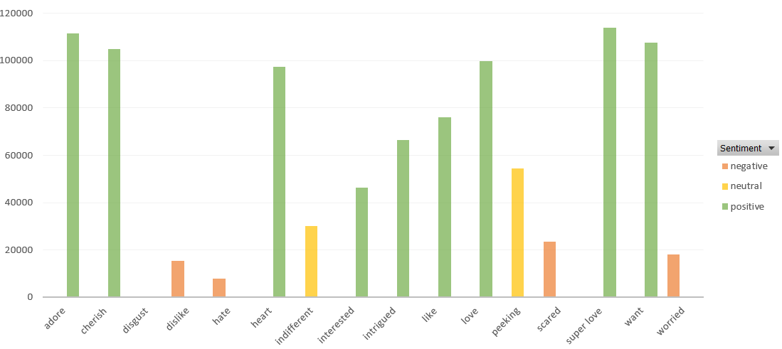
Sum of the Score of Sentiments by Content Type
Here is sum of the scores of sentiments for the content type,
`
Notes:
Positive Sentiment: Notable content types with high positive sentiments include "adore," "cherish," "like," "love," "super love," and "want."
Neutral Sentiment: The "indifferent" and "peeking" content types show significant neutral sentiment.
Negative Sentiment: Content types like "disgust," "dislike," "hate," "scared," and "worried" show a higher prevalence of negative sentiment.
Adore & Love:
Both "adore" and "love" content types have the highest positive sentiment values, exceeding 100,000.
These content types are crucial for driving positive engagement on the platform.
Cherish & Super Love:
Similar to "adore" and "love," these content types also show strong positive sentiment, indicating they resonate well with the audience.
Like & Want:
High positive sentiment is also seen in "like" and "want" content types, making them valuable for content strategy.
Interested & Intrigued:
These content types are predominantly positive, with "interested" showing slightly more positive engagement than "intrigued."
Peeking & Indifferent:
"Peeking" has a notable neutral sentiment, possibly indicating curiosity or passive interest.
"Indifferent" content shows a balanced distribution of neutral sentiment, suggesting mixed audience reactions.
Negative Sentiments (Disgust, Dislike, Hate, Scared, Worried):
These content types have significant negative sentiment values.
"Scared" and "worried" show particularly high negative sentiment, indicating these posts might be about concerning or distressing topics.
Implications and Recommendations
Positive Engagement:
Focus on creating and promoting content types that generate positive sentiment such as "adore," "cherish," "like," "love," "super love," and "want."
These content types drive higher engagement and positive interaction on the platform.
Neutral Content:
For content types like "peeking" and "indifferent," consider strategies to convert neutral engagement into positive sentiment.
Analyze why these posts are perceived neutrally and adjust content strategies accordingly.
Negative Sentiment Management:
Monitor and evaluate content types that attract negative sentiments.
Implement strategies to mitigate negative reactions, possibly by addressing the concerns or negative aspects related to these content types.
Consider limiting or rephrasing posts that lead to high negative engagement, such as those labeled "scared," "worried," "disgust," "dislike," and "hate."

Slide 11

In this presentation, we conducted a thorough analysis of Social Buzz's data to provide actionable insights for their upcoming IPO and to enhance their big data practices. The key findings from our three-month project POC include:
Top 5 Best-Performing Categories: Identified the most engaging content categories, which can inform content strategy and marketing efforts.
Sum of the Score for Reaction Types by Quarter: Revealed quarterly trends in user engagement, helping to optimize content release schedules and marketing campaigns.
Sum of the Score of Sentiments by Content Type: Highlighted the emotional impact of different content types, guiding the creation of content that resonates positively with users.
These insights will help Social Buzz capitalize on their vast content production, enhance user engagement, and strategically position themselves for a successful IPO.
Summary

Slide 12

Thank you!
ANY QUESTIONS?

